Slide 1
Data Science
Predictive Analysis of Healthcare - Diabetes
Submitted to : Dr. Awais Hassan
Submitted by : Tahniyat Javaid
Roll No: MSDS-113

Slide 2
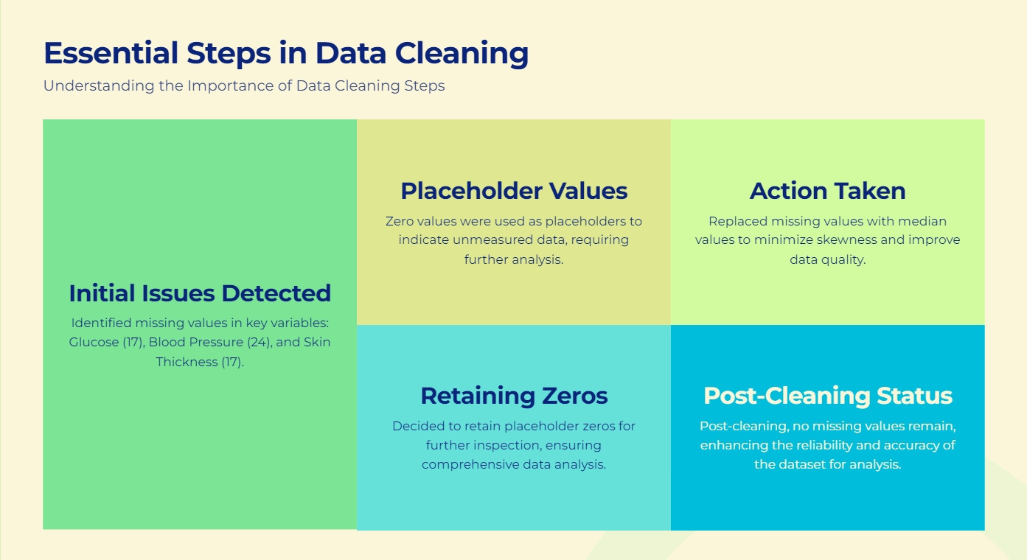

Slide 3
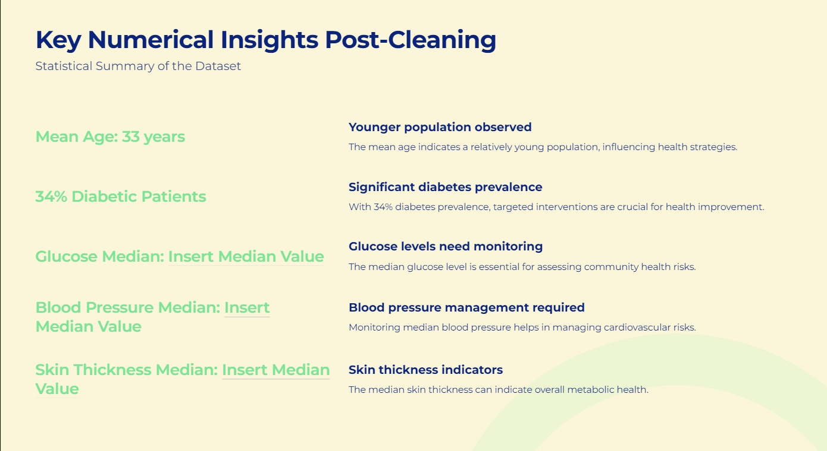

Slide 4
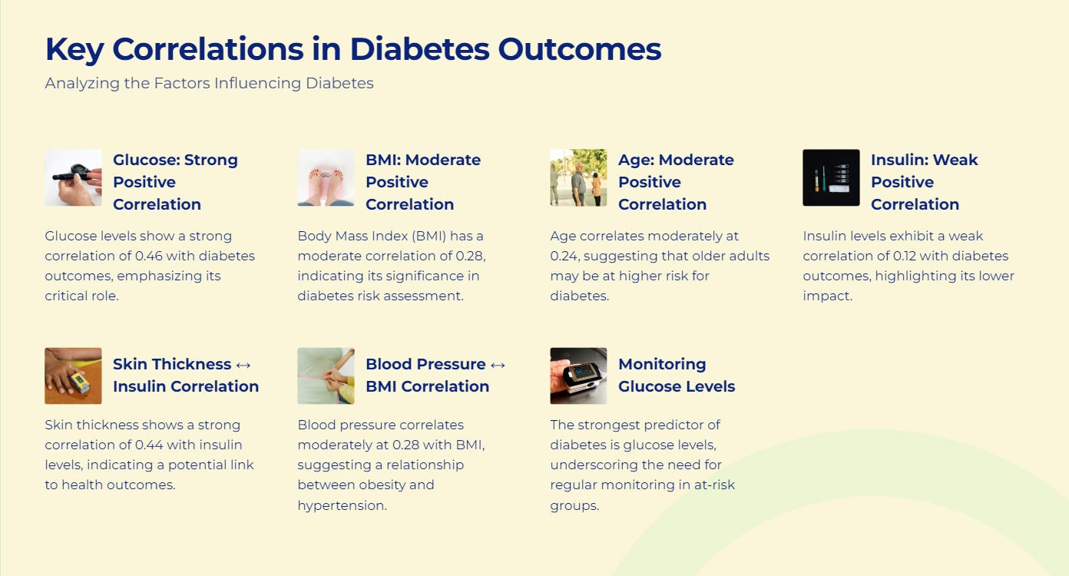

Slide 5
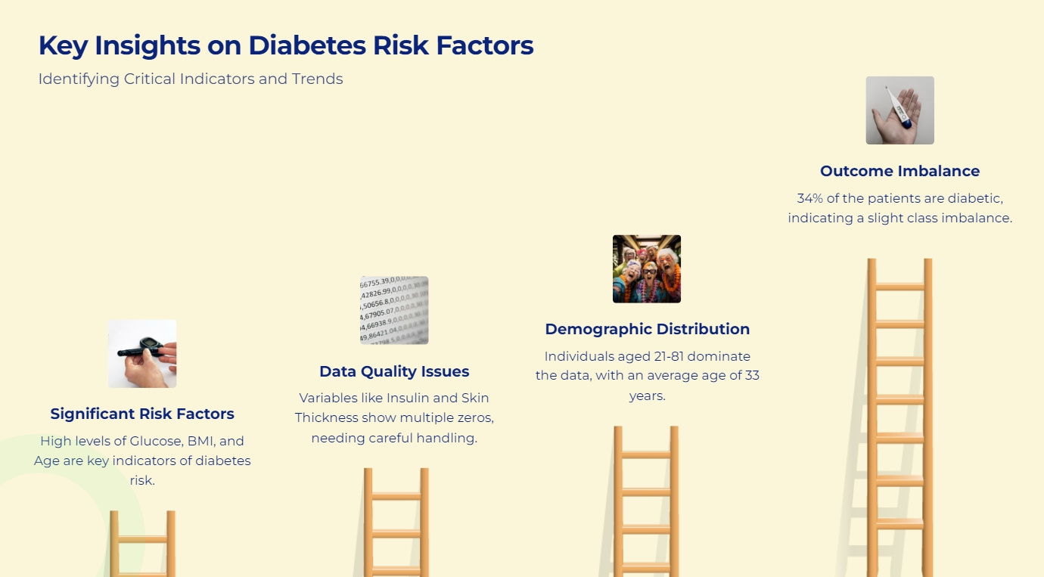

Slide 6
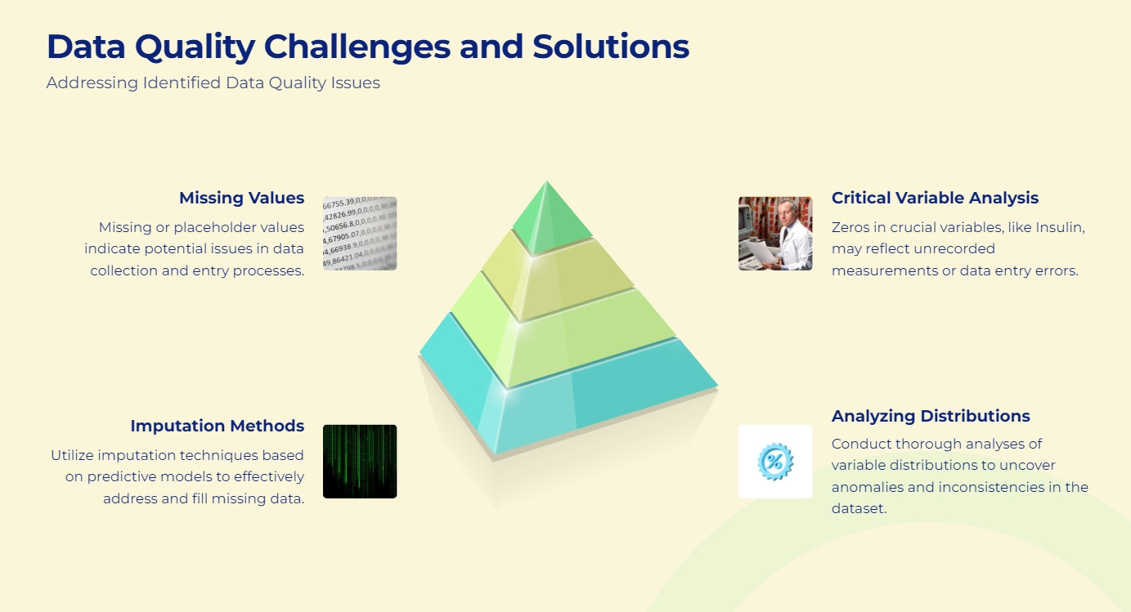

Slide 7
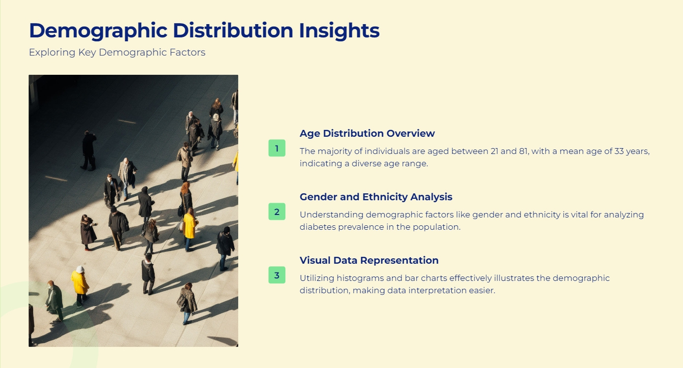

Slide 8
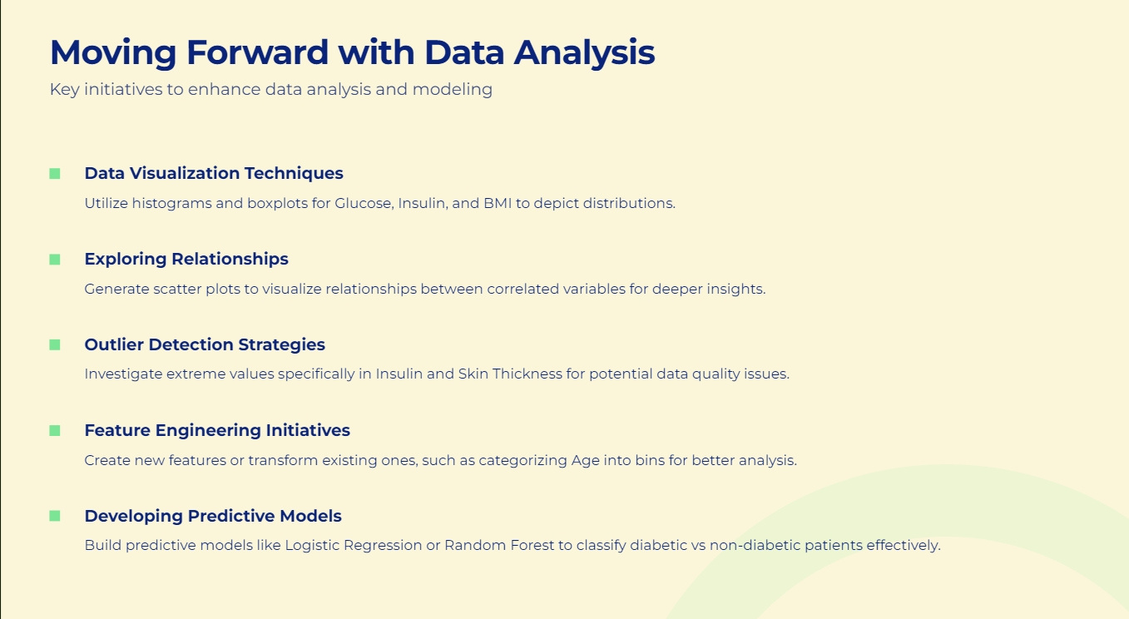

Slide 9
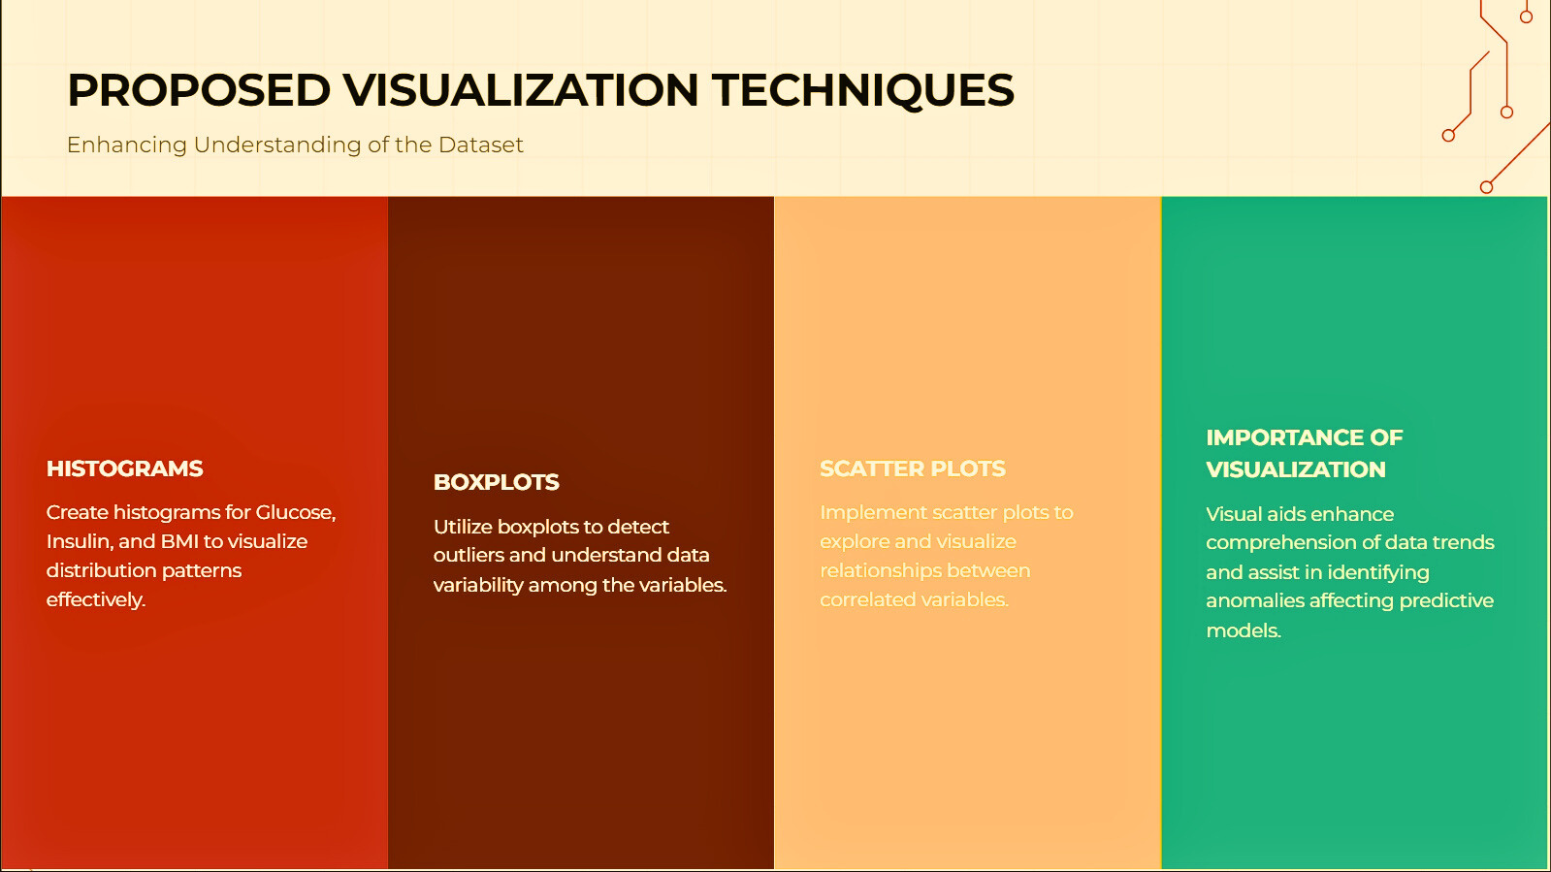

Slide 10
